Slide 1
FBS
User Research
(New Industry filters)
July 2020
Anubhav Mittal

Slide 2
Who we tested with
10 Online un-moderated test sessions, with Userzoom panel, for usability testing
Male – 4 / Female – 2 / Undisclosed - 4
Region – UK wide
Date – 8th July 2020

Slide 3
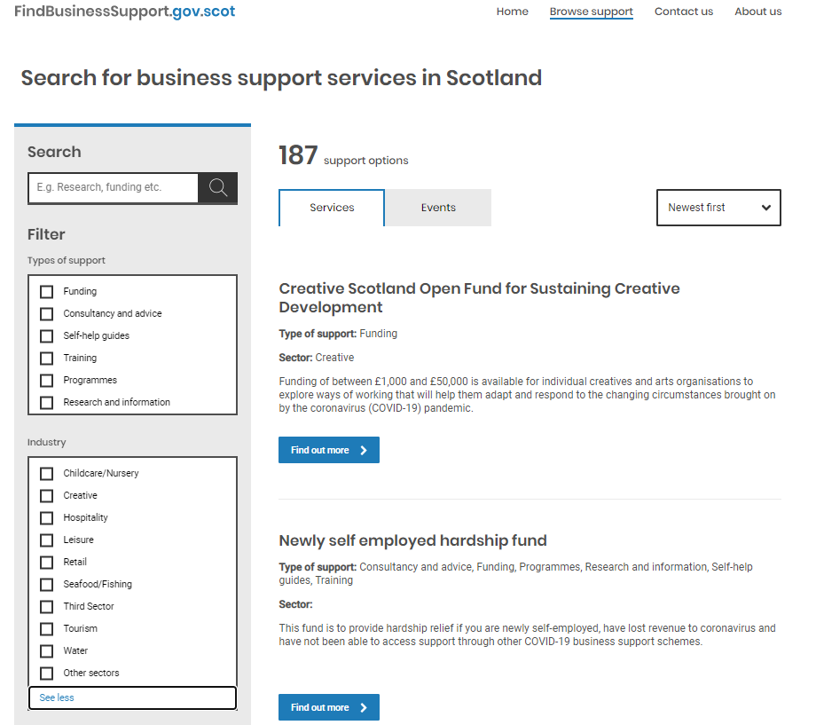
What we were trying to find out
We explored the following thing:
Users views on the new industry filter under the Browse support webpage (their likes, dislikes, if they were able to understand “other sectors” tag and if anything was missing)

Slide 4
Summary
Users found the new industry filter easy to use, simple and easy to find.
Simple, plain, easy to use, logical were some of the comments made by the users.
Some dislikes included the design being a bit bland, colourless, some sectors being left out like farming, finance, digital.
Users understood what the “other sectors” industry tag meant and were happy with the search results displayed when it was selected.
Overall users were happy with the search and filter options that were available under the browse support web page.

Slide 5
FBS New Industry filter feedback
We asked the users about their likes and dislikes upon looking at the new industry filter panel - https://se-uat-singleentrypoint.azurewebsites.net/browse-support#!Products=/newest-first/show+25/page+1 following things were mentioned:
Top 3 likes per user Top 3 dislikes per user
Top 1 | Top 2 | Top 3
easy to understand the options available | variety of things on the list | easy to use
Clear | Logical | Comprehensive
Great way to show and hide lots of information | only showing the information I want to see while hiding the rest | Quick and easy to use
Simple | Neat | Easy to use
The variety | the layout | See more option
easy to find | easy to navigate | easy to find relevant information
I like the way how much they can offer for the creative org. | The information given offers clarity on how to move forward to adapt | The industry filter gives helpful options with a few good search results because it helps me exactly on what I am looking for.
I like the filter feature | I think this really help narrow down the information you need | I like it simple
easy to use | brings all the results required | good amount of industry options
simple | straightforward | plain
Top 1 | Top 2 | Top 3
"other sectors" seemed very broad | bland color scheme
Limited | General | Not inclusive of new business
Could be even more listed | No search option if yours isn’t included | Specific search bar
looks a bit boring
every tick you do in the filter it starts to search | too plane | the layout is good but missing some design in it
needs more of a flow to it | needs a drop-down box | less industry options
colorless | not easy to navigate | bland

Slide 6
FBS New Industry filter-missing?
When we asked the users if there was anything missing from the filters following things were mentioned:
Farming | Mining, Gathering, Extracting | Medical care and/or Protective services
maybe government | or private
more options for sectors | more options for support | drop down box to narrow it down for specific industries.
finance | digital - of some description

Slide 7
FBS New Industry filter- “other sectors”
When we asked the users what “other sectors” filter tag mean to them, following things were mentioned:
it means anything not covered under what is already listed | where you might find further information | might find more detailed information
Sectors that were not listed previously
sectors which don’t fit in the above categories
Anything that does not fit into the pre - mentioned categories | New business | industries which don’t have a category
Other sectors that aren’t highlighted
sectors not already listed | maybe smaller industrial sectors
TV and Film | Performing Arts | Workshop facilitators
maybe this is for undefined sectors | sectors you cannot categories | unknown sector
variety of other job sectors | more jobs | relevant jobs
everything else

Slide 8
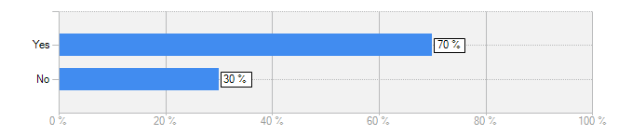
FBS New Industry filter- “other sectors”
Is it easy to understand the industry label "other sectors"?
Yes=7 / No=3
I didn’t have any problems understanding the sector labels
Presumably means sectors not covered under main menu
Other surely means everything else
It seems relatively self-explanatory to me that this would be to describe other sectors of business that aren’t on the list.
I believe it generalizes business sectors making it difficult to distinguish between relevant sectors.
No, the reason for that is because it could be any other sector which i might not like or not know off and that could mean anything the word "other sectors" so not really too keen as to what would mean if there are a variety of other sectors that are being displayed.
To me this section included more than just information for sectors which don’t fit into other categories. It also included more general guides for all industries. To me this was confusing.

Slide 9
Thank you!

